Slide 1
AN Art Gallery of Work Products

Slide 2
Business & Corporate Law: Entity formation

Slide 3
Business & Corporate law: corporate financing

Slide 4
Business & corporate law: Business Valuation

Slide 5
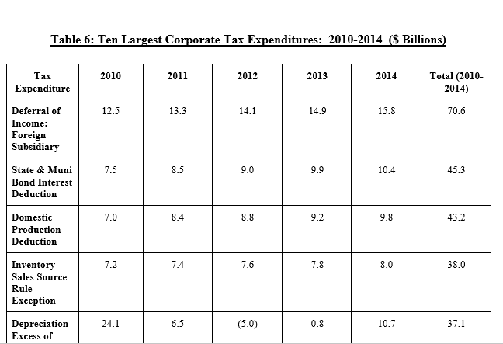
TAX LAW: Corporate Tax reform

Slide 6
Tax law: use taxes in the internet age

Slide 7
International Law & IP

Slide 8
Legal analytics & e-discovery

